Slide 1
ELECTRICAL PROGRESS REPORT WEEK 11
TEAM
-Eunice Orenge
-Laban Mwangi
-Stephen Kinuthia
-Victor Maina

Slide 2
OBJECTIVES OF THE WEEK
a) Mount components on the PCB and solder them.
b) Visualize the voltage distribution from the battery.
c) Assist the navigation team in building the tractor navigation app.

Slide 3
a) MOUNTING AND SOLDERING OF COMPONENTS ON PCB
PCB fabrication had been completed; etching and drilling of the double sided PCB clad.
Components were now to be mounted and soldered onto the board.
We however encountered alignment issues; the top side and bottom were not well aligned and fabrication had to be repeated.

Slide 4
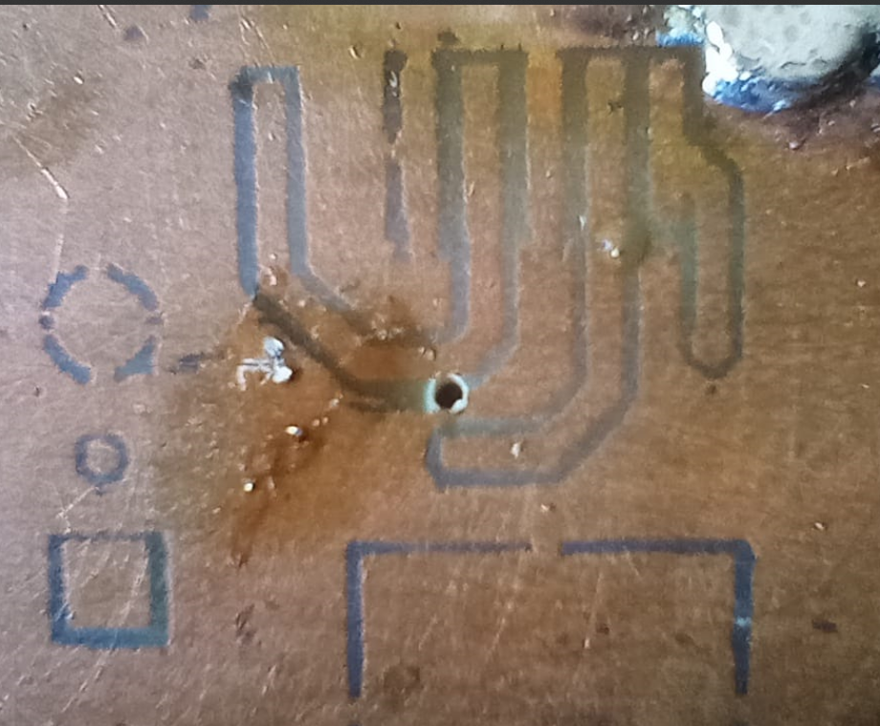
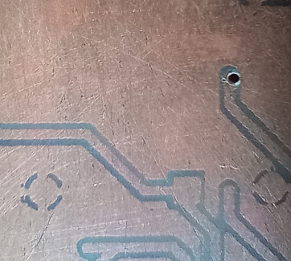
PCB MISALIGNMENT

Slide 5
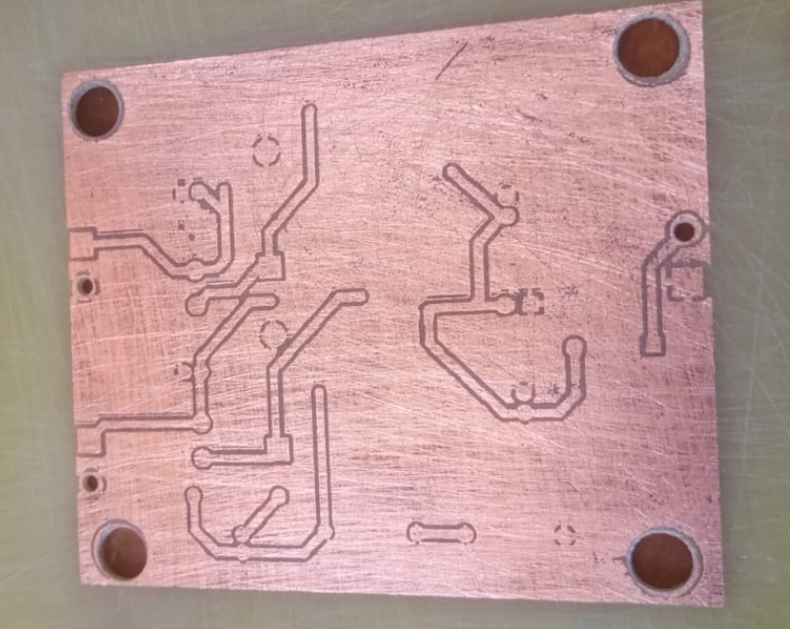
MISALIGNMENT SOLUTION
We first drilled the mounting holes and other 3 component holes at the edges.
We used these holes to align the second layer onto the clad for ironing.

Slide 6
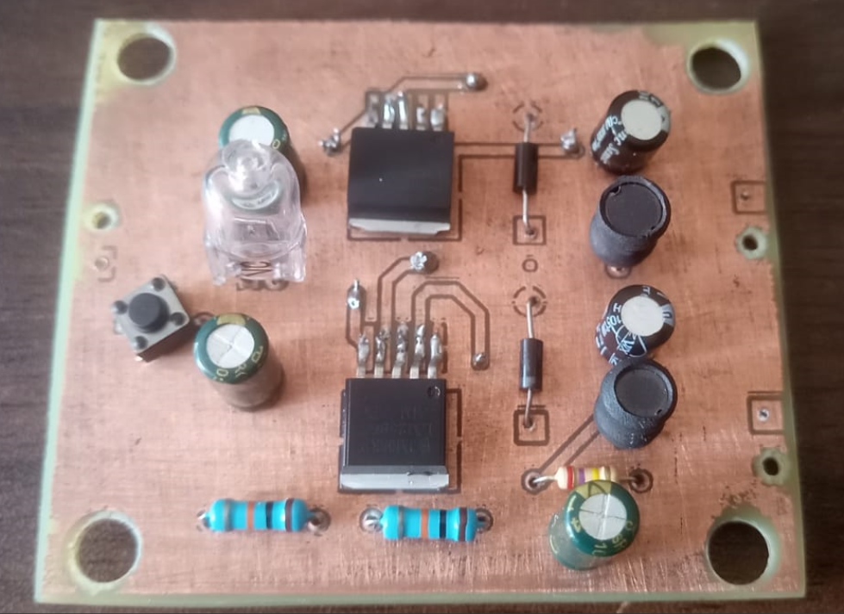
MOUNTING OF COMPONENTS
Components were then mounted and soldered on the board.
The input and output terminal screw blocks were unavailable at the stores.

Slide 7
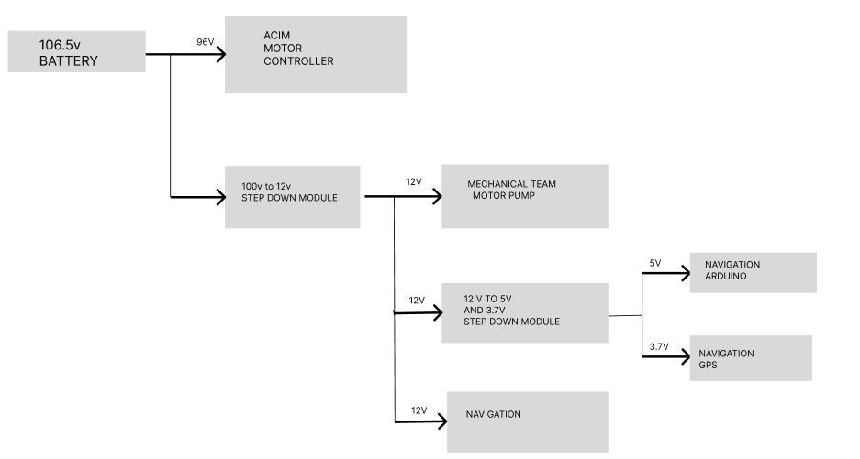
b)VISUALIZE VOLTAGE DISTRIBUTION FROM BATTERY

Slide 8
C) NAVIGATION APP PROGRESS
We are trying different algorithms to try and plot the tractor plough paths.

Slide 9
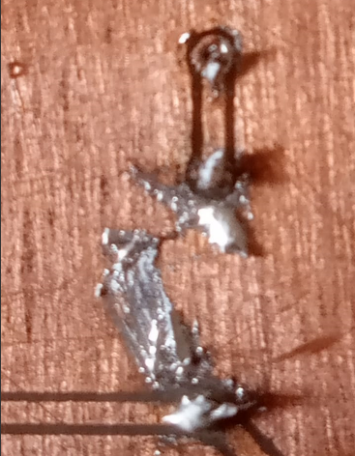
CHALLENGES ENCOUNTERED
Soldering of the components onto the copper clad. Some solder leaked into the ground plane area thus causing shorting.
Learning point- To leave more allowance between the tracks and other planes.

Slide 10
TASKS TO BE DONE
Cleaning up the solder joints.
Controller testing.

